Slide 1

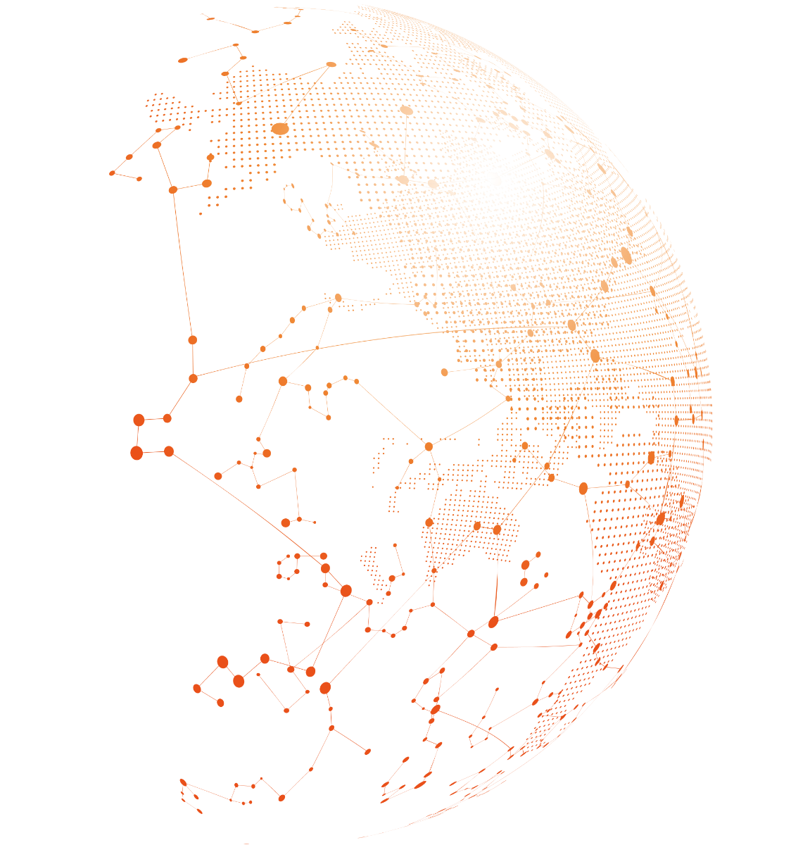


ITS/GET/2/20
Organized by
Alibaba GET Global Challenge
Digital Solutions During and Beyond COVID-19
TEAM STATEMENT
<Institution Name>
<Team Name>

Slide 2
ITS/GET/2/20
What problem(s) are you trying to solve?

Slide 3
ITS/GET/2/20
Why you and why now?

Slide 4
ITS/GET/2/20
Who are in your team and what are their roles?
Please provide background information for each team member

