Slide 1
2020 BEM Bulk Registration
Faculty of Engineering, Professional Development Committee

Slide 2
1. Applicable to students graduating Trimester 1 2019/2020, Trimester 2 2019/2020, and Trimester 3 2019/2020 only.
2. You should register even if you choose to pursue postgraduate studies / other fields of career immediately upon graduation.
3. Registration till 30 June 2020. Late submissions will not be entertained.

Slide 3
OBJECTIVE
Encourage registration of Graduate Engineers with the Board of Engineers (BEM)
Registration of Engineers Act 1967 - Revision 2015 (REA1967 rev. 2015) gazetted on 31st July 2015 – among others, addresses issues on liberalisation/mobility of Engineers due to Free Trade Agreements (FTA) between countries.
  A person practising engineering must register with BEM
Registration during the convocation will ensure majority of engineers register immediately after graduation
Prevents fraud.
Registration with the BEM is an added advantage when job seeking.
All professional experience only count from date of registration with BEM.
Many engineering graduates remain unaware of this and their professional growth is hindered.
WHY?

Slide 4
Malaysians
Legally required to practice engineering in Malaysia.
Useful to work in Washington Accord signatory countries.
WHO?
Non-Malaysians
Optional for Non-Malaysian who wish to practice in Malaysia.
Non-Malaysian must provide copy of passport and valid visa

Slide 5
BEM Bulk 2020 Registration Process – Malaysian
Fill in Google Form at shorturl.at/kSU08 . You must sign in using your mmu email.
Pay online to Multimedia University – Amount RM 50.00 details at https://www.mmu.edu.my/financial-info/
Every payment done, student is to write in the reference column their Student ID and “BEM Registration”.
example ,1161666661 BEM Registration
Email scan copy , in 3 separate files of the following and email to husnahidayah@mmu.edu.my:
  Proof of payment to Multimedia University , RM50.00
(online banking slip- ref example : 1161666661 BEM Registration)
ii. passport photo softcopy (JPEG)
IC Scan (PDF)
Students will receive a notification via email once full registration with BEM is successful. The tentative
registration notification time is December 2020.
5. Certificate of registration will be couriered to student mailing address.
HOW?

Slide 6
Registration Process – Non Malaysian / Masters / PhD
International are advised to register AFTER they have obtained their official degree scroll and transcript (after Convocation).
Register online at https://engineer.org.my/Account/Login?ReturnUrl=%2F
HOW?

Slide 7

Need for degree certificate is waived.
If student chooses to register by themselves, they need to get the relevant documents certified by a P.Eng
Additional cost of RM15 for courier charge
Only students who register through MMU will be entitled to win the BEM Award
Statistics show that most students will forget about the application process until the need arises, and by then a lot of professional experience would be wasted as it was not recorded officially.
Let me do this by myself AFTER I get a job?

Slide 8
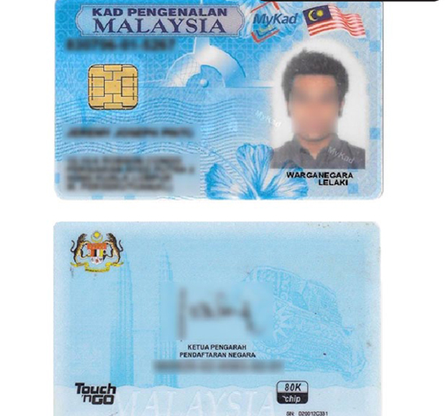
IC photocopy example
Please strike off ( as example)
FOR BEM USE ONLY
FOR BEM USE ONLY

